Slide 2
Real-Time Chat Application
Submitted to:
Department of Computer Science and Engineering

Slide 3
Supervised by: Dr.Praveen Bhanodia
Team Members
1.Dev Gupta(0827CS211068)
2.Diksha Makode(0827CS211077)
3.Garima Nagdeve(0827CS211082)
4.Harsh Shukla(0827CS211092)

Slide 4
Project Presentation Outline
Introduction
Problem Statement
Survey of Existing Systems
Project Objectives
Requirement Analysis
Solution Proposed
Features
System architecture
User Interface
Testing Plan
The Outcome Discussion
Conclusions

Slide 5

Introduction
Introduction about our project
Our project is titled “LinkUs: An Anonymous and Secure Chat Application.”
LinkUs: Innovative chat app tackling spam, privacy, and security issues. Ensures user anonymity with secure usernames, enabling seamless and secure online communication in chat rooms.

Slide 6
Introduction
The motivation behind undertaking the specific problem:
Our motivation for embarking on this project stemmed from the frustration experienced by a friend who constantly received spam calls on her shared WhatsApp number. This issue not only caused distractions but also raised serious concerns about privacy and security. We were inspired to develop LinkUs as a solution to empower individuals with a secure and private online communication platform. Leveraging the MEAN stack and real-time communication technologies like WebSockets or Socket.io, we aim to explore the realm of real-time communication and provide users with a chat application that prioritizes their privacy and security. LinkUs aims to revolutionize online interactions, offering users a secure space for digital communication.

Slide 7
The Problem Statement
Develop a real-time chat application that allows users to create chat rooms, join conversations, exchange messages in real-time
Utilize the MERN stack along with technologies like WebSockets or Socket.io for real-time communication.

Slide 8


Survey of Existing Systems
Advantages | Disadvantages
Instant Messaging: Send texts, media, and even voice messages instantly. Group Chats: Communicate with multiple people at once. Encryption: Messages are encrypted, enhancing privacy. | Requires Phone Number: Users need to share their phone number for registration. Limited File Sharing: Sharing large files can be a bit challenging. Dependency on Internet: Requires a stable internet connection for communication.
Advantages | Disadvantages
Seamless Integration: Integrates with Facebook, making it easy to connect with friends. Chat Heads: Offers floating chat heads for multitasking while messaging. Rich Media Sharing: Share photos, videos, GIFs, and more. | Privacy Concerns: Users might feel their data is being used for advertising. Resource Intensive: Can consume a significant amount of device resources. Interface Complexity: Some users find the interface cluttered.

Slide 9


Survey of Existing Systems
Advantages | Disadvantages
Enhanced Privacy: Offers self-destructing messages and end-to-end encryption. Large File Sharing: Users can share files up to 2 GB each. Channels and Bots: Users can join channels and interact with bots. | Smaller User Base: Fewer users compared to WhatsApp or Messenger. Stickers and Bots: While fun, some might find stickers and bots distracting. Video Calling Limitations: Video calls are available but may not be as advanced as other apps.
Advantages | Disadvantages
Temporary Messages: Messages and media disappear after a short time. Lenses and Filters: Offers fun filters and interactive lenses. | Learning Curve: Some users might find the interface confusing initially. Privacy Concerns: Despite temporary messages, privacy concerns have arisen.

Slide 10

Survey of Existing Systems
Advantages | Disadvantages
Visual Content: Instagram is primarily a visual platform, making it ideal for sharing and discovering photos and videos. Marketing and Branding: It's a powerful tool for businesses and influencers to market products, services, and personal brands. Creativity: Users can showcase their creativity through photography, videography, and artistic expression. | Privacy Concerns: The platform has faced criticism regarding user privacy and data collection practices. Comparative Nature: Users may feel pressured to present a curated, idealized version of their lives, which can lead to anxiety and insecurity. Addictive: Like other social media, Instagram can be addictive, with users spending excessive time scrolling through their feeds.

Slide 11
Objectives
To Create a feature for users to send and receive text messages instantly.
To Make sure messages are delivered and received in real-time for responsive conversations.
To Ensure users can chat seamlessly on different devices.
To Implement end-to-end encryption to protect message content, accessible only to senders and recipients.
To Create the ability for users to chat with multiple people simultaneously.
To Configure the app to send notifications for new messages and updates.
To Create an easy-to-use interface suitable for users of all technical levels and ages.
To Connect users globally, regardless of geographical location, to foster communication between individuals, families, friends, and colleagues worldwide.

Slide 12
Requirement Analysis
Functional Requirements:
User Registration & Authentication
User Profiles
Email Management
Messaging (text)
Group Chat
Real-time Updates & Notifications
Message History & Search
Non-Functional Requirements:
Performance (low latency)
Scalability (horizontal scaling)
Reliability (high availability)
Security (encryption, secure authentication, protection against threats)
Usability (intuitive UI)
Performance Monitoring
Load Testing
Support and Maintenance

Slide 13
Solution Proposed
Here's our strategic blueprint, outlining the techniques and methods applied in the development of our project:
Step 1: Understand the Basics:
Step 2: Choose the Right Tools:
Step 3: Design the User Interface:
Step 4: Build the Backend:
Step 5: Implement Real-Time Functionality:
Step 6: Enable User Authentication:
Step 7: Integrate Group Chats:
Step 8: Ensure Privacy Controls:
Step 9: Deploy our App:

Slide 14
Features
These features make our app a user-friendly and secure platform for efficient communication worldwide
Instant Messaging
User-Friendly Interface
Group Chats
No sharing of number
Secure Sign-Up
Notifications
User Profiles
Search Messages
Privacy Controls
Real-Time Updates
Global Connectivity
Efficient Communication

Slide 15
System Architecture
Let’s imagine the architecture of our chat application as a team of specialized assistants, each assigned a vital role to make chatting effortless and enjoyable.
User Interface (UI)
Client-Side App (Frontend)
Server (Backend)
Real-Time Engine
Database
User Authentication
Group Chat Manager
Privacy Controller
Notification Sender
Data Security Layer

Slide 16
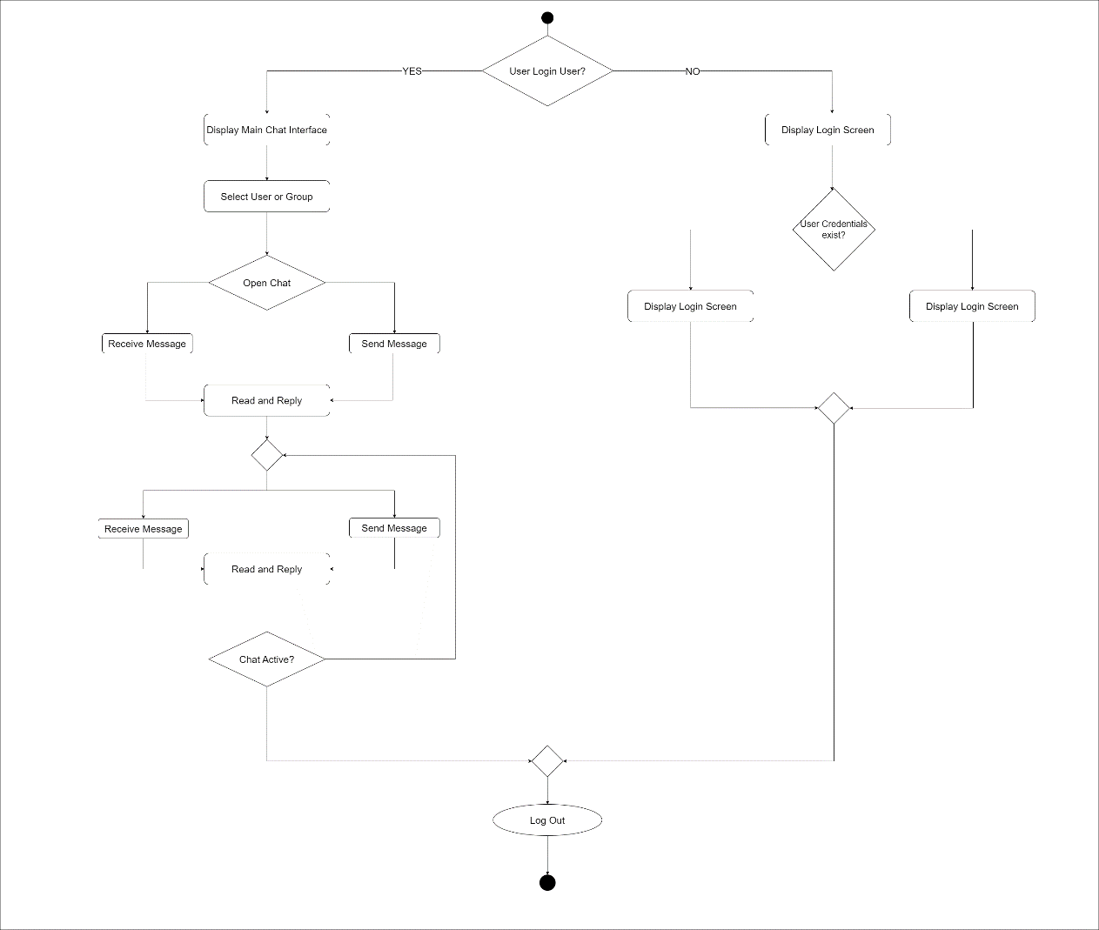
Flow Diagram of Real-Time Chat Application

Slide 17
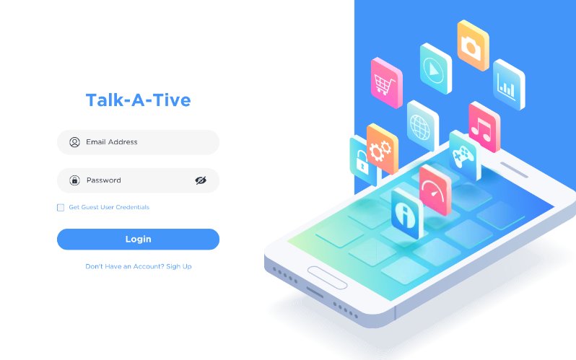
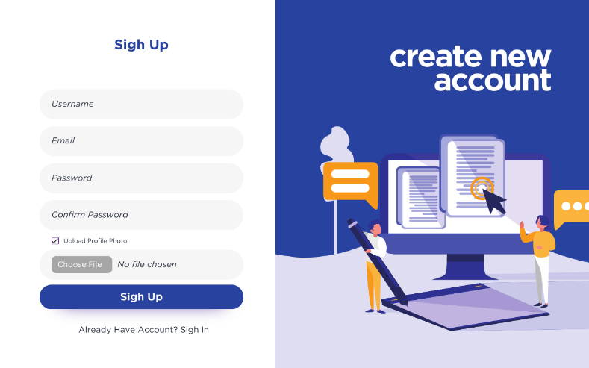
User Interface
Login page interface will be opened as soon as you access the URL of the application.
For users who don’t have the account to, create account.
As soon as the user sign up upload profile picture option will be shown.

Slide 18
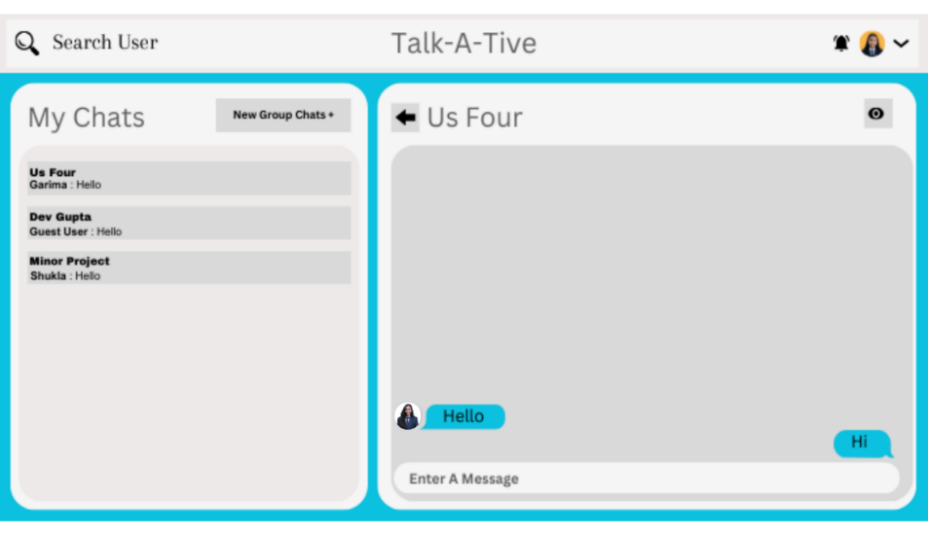
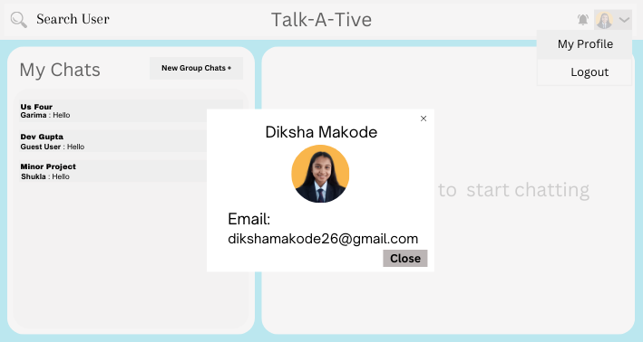
User Interface
For chatting interface user will have the option to search the other user by their usernames. Also user will have options like my chats , new group and view profile.
Profile will show your username, email and profile photo and also will enable you the funcationalities like editing your profile and changing you profile picture.

Slide 19
Testing Plans
Unit Testing: Imagine inspecting each brick of a building. We'll examine every piece of our chat application individually to make sure they're working correctly, just like ensuring each brick fits perfectly.
Integration Testing: This is like checking if the different parts of your chat application collaborate well. It's similar to ensuring all the rooms in a house are connected seamlessly.
User Interface Testing: We'll confirm that our chat application looks appealing and is user-friendly. It's like making sure our chat application feels as inviting as a beautifully designed room.
Performance Testing: We'll assess how quickly your app loads and responds. It's to checking if the doors of a house open and close effortlessly.
Security Testing: This focuses on safeguarding our chat application from any potential harm. It's like adding locks to your house to ensure everything inside remains secure.
User Acceptance Testing: Before sharing our chat application widely, we'll let a small group of users try it out. Their feedback helps us refine your app to ensure everyone enjoys a top-notch experience.

Slide 20
The Outcome
Project outcomes include:
Staying Connected: Our chat application ensures friends and family can connect instantly, breaking the barriers of distance. It's like having a magical bridge that effortlessly brings loved ones closer with just a simple tap.
Efficient Planning: Group chats streamline event and outing planning. Imagine everyone brainstorming ideas together in one digital space, akin to a virtual meeting room where collaboration is seamless.
Personal Privacy: With secure sign-ups and usernames, personal information remains completely private. It's like having a unique secret key that unlocks your chat world, ensuring your privacy is preserved.
Exciting Real-Time: Instant messaging and live updates add an exciting dynamic to conversations. It's like experiencing the energy of a lively in-person chat, even in the virtual world.

Slide 21
Conclusion
As we come to the end of our chat application project journey, let's look back at how far we've come. From the initial idea of a seamless communication tool to the present reality of a thriving chat app, the road has been transformative.
Today, our chat app stands as a vibrant hub connecting people across the globe. With its real-time chats, user-friendly design, and strong security, it has become a trusted companion for many. But this is just the beginning. Looking ahead, we're dedicated to continuous improvement. We'll refine the app's features, embrace new technologies, and adapt to the evolving needs of our users.
The story of our chat app is a blend of past aspirations, current achievements, and future promises. It's about enabling effortless conversations that transcend distances. As we step into the future, we invite you to be part of this journey, where technology and connection intersect to create something truly remarkable

Slide 22
Acknowledgment
We express our deep gratitude to:
Assistant Professor, Department of Computer Science & Engineering, for her valuable guidance and suggestions throughout my project work.
Project Coordinator, for his valuable guidance.
Head of Department, for his timely suggestions to complete our project work.
Director, for providing us with the facilities to carry out our project work.

Slide 23
Q&A

Slide 24
THANKS

